Slide 1
Incongruence and ILS
PhyloSeminar 2024
Julia Hobbie

Slide 2
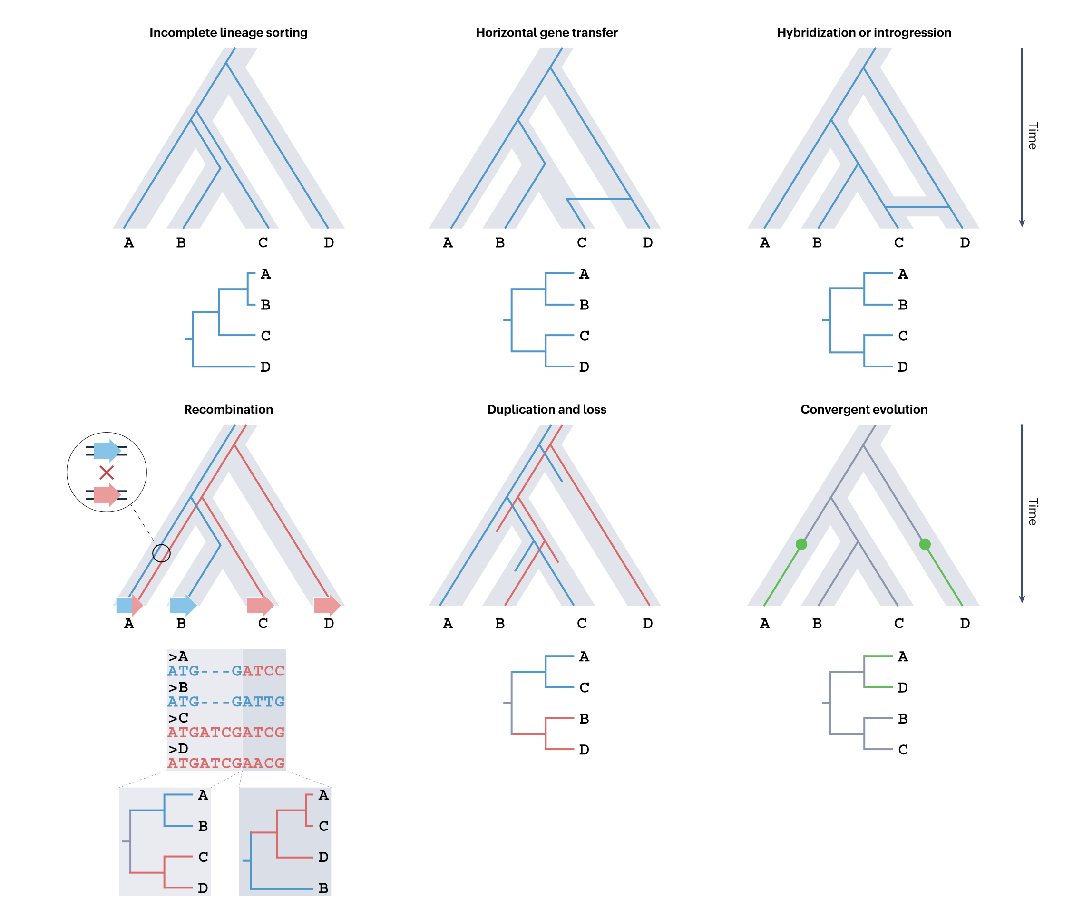
What is Incongruence?
When the topologies of inferred trees don’t match up
Can be due to
Analytical factors (taxon or locus sampling, orthologues, LBA, alignment, etc)
Biological factors

Slide 3
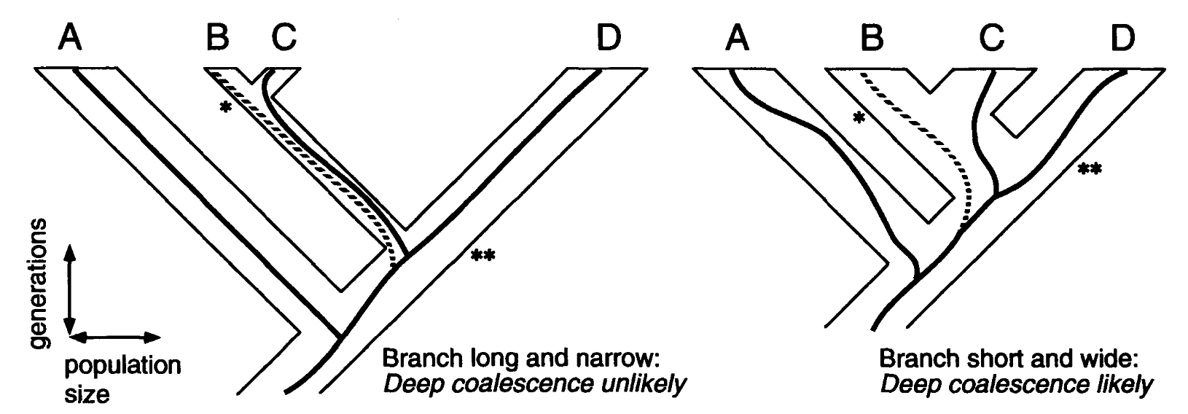
Incomplete lineage sorting
Polymorphisms are preserved through a lineage split, so alleles coalesce farther back than the species split
Increased probability when populations are large and the time interval between speciation events is short. More detectable in recent divergences.
Address with multispecies coalescent model
BEAST: uses Bayesian statistics to co-estimate gene trees and species phylogenies in the presence of ILS (comp. expensive)
Summary coalescent-based models: infer species trees from pre-inferred single-gene trees (increased error rates)

Slide 4
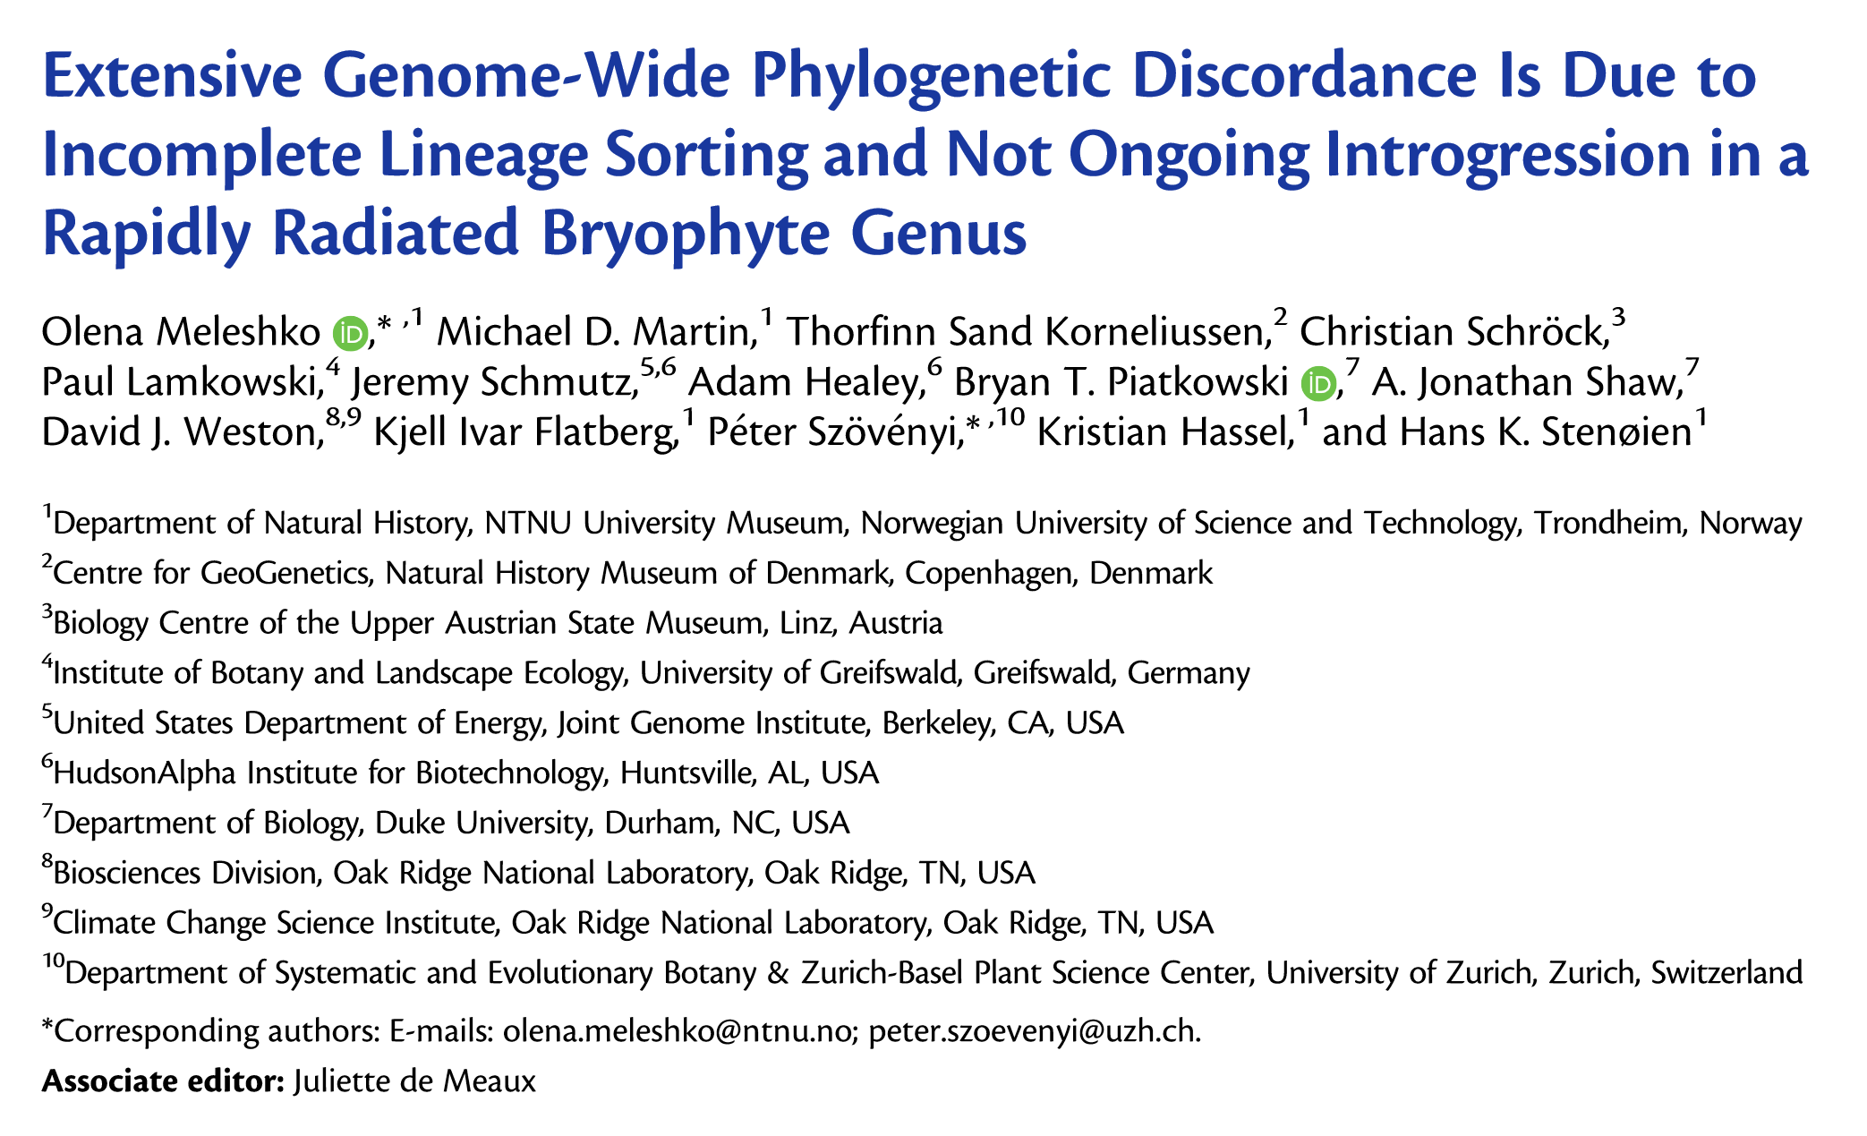
Mol. Biol. Evol. doi:10.1093/molbev/msab063 Advance Access publication March 3, 2021

Slide 5
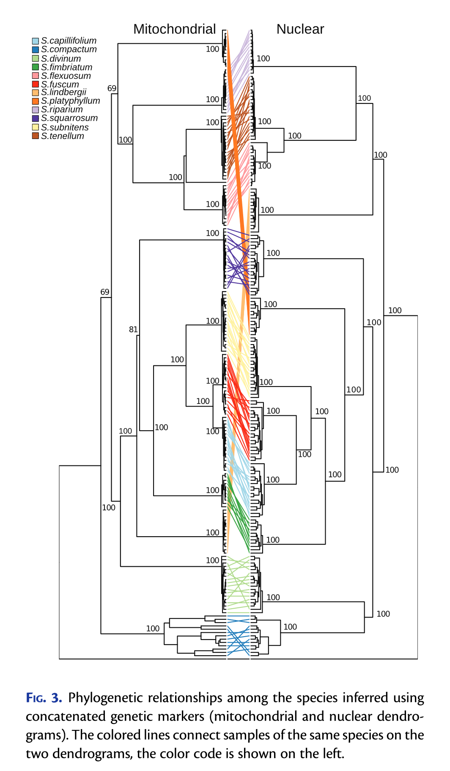
Organellar vs nuclear phylogenies

Slide 6
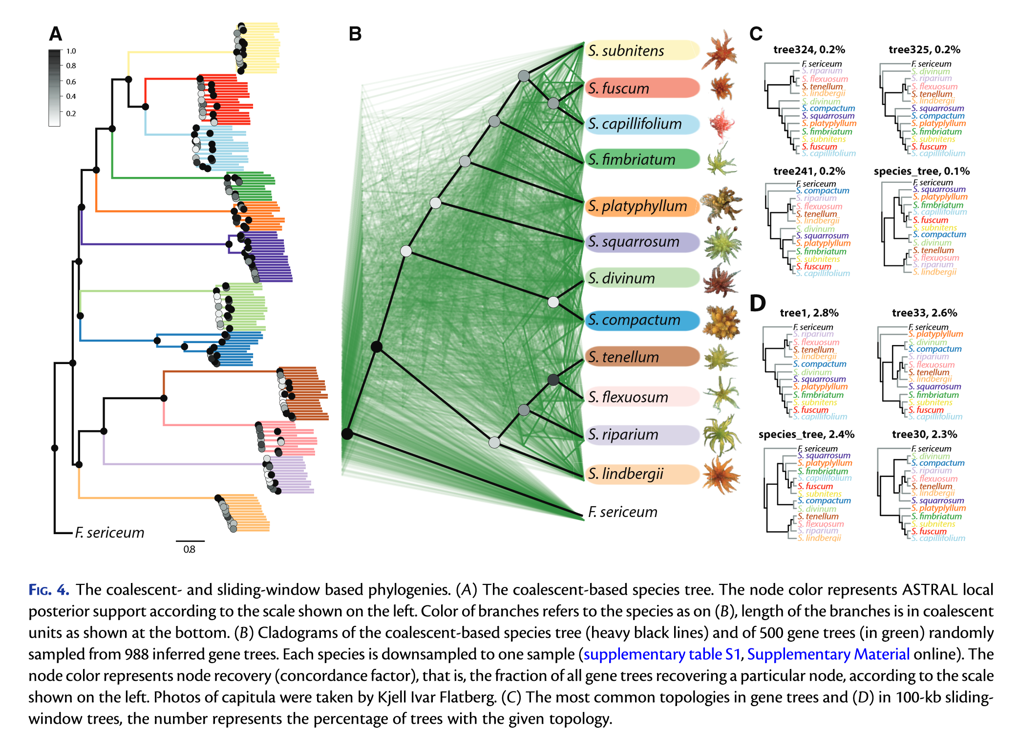

Slide 7
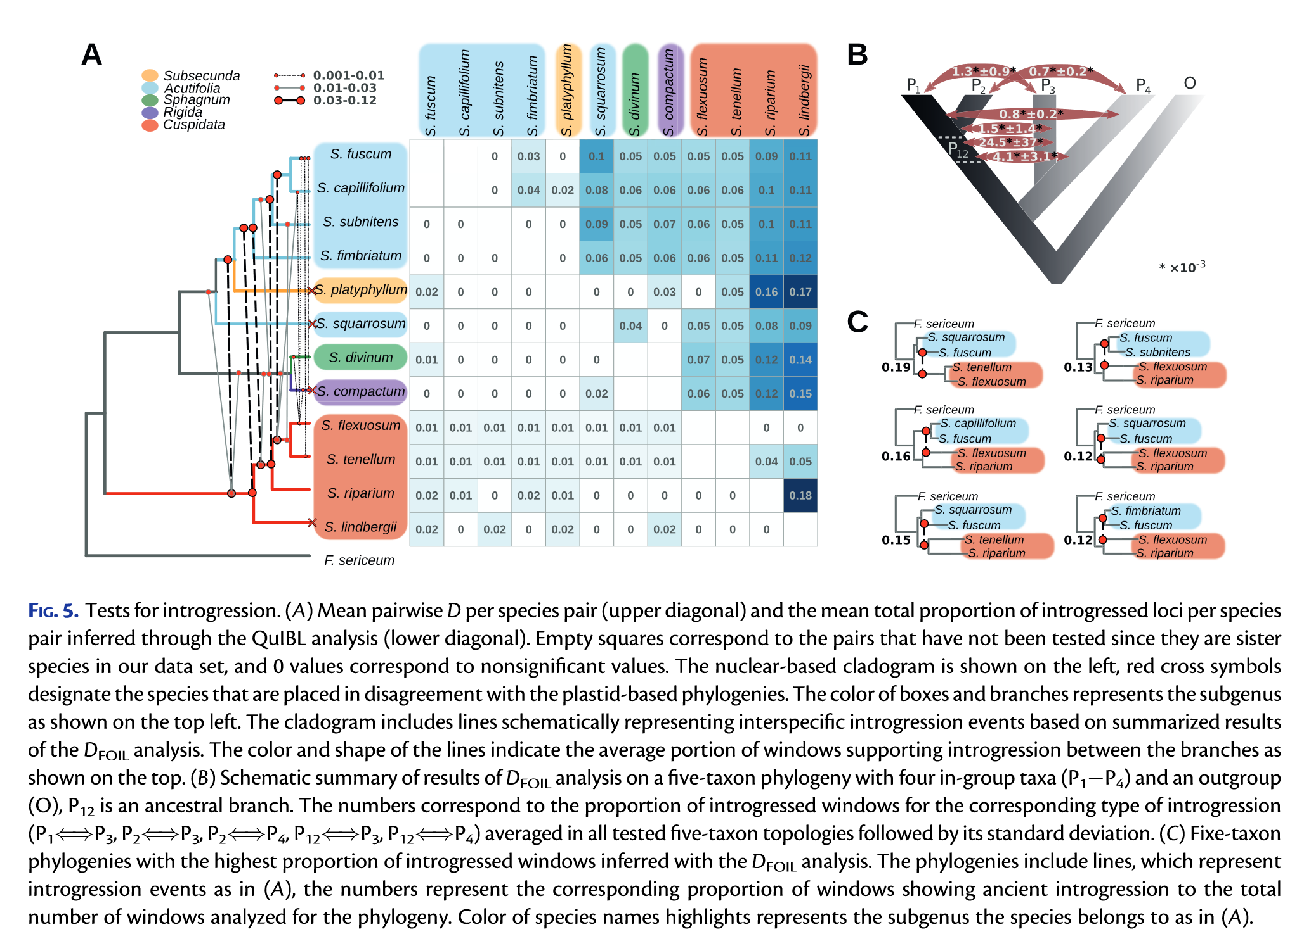
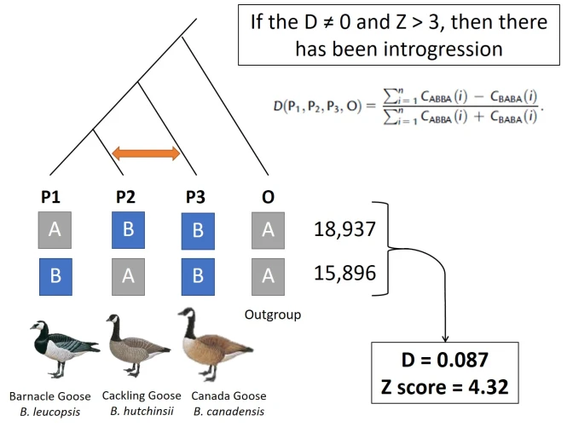

Slide 8
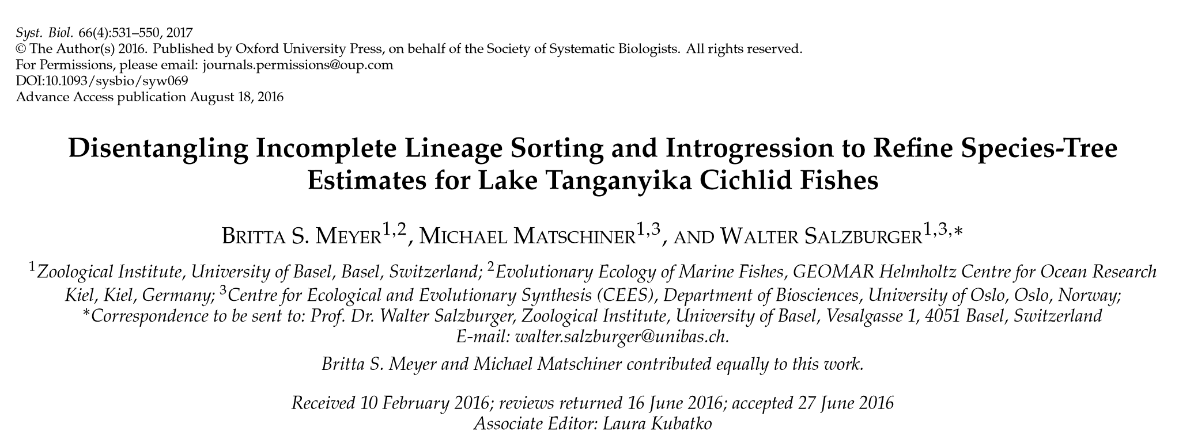

Slide 9
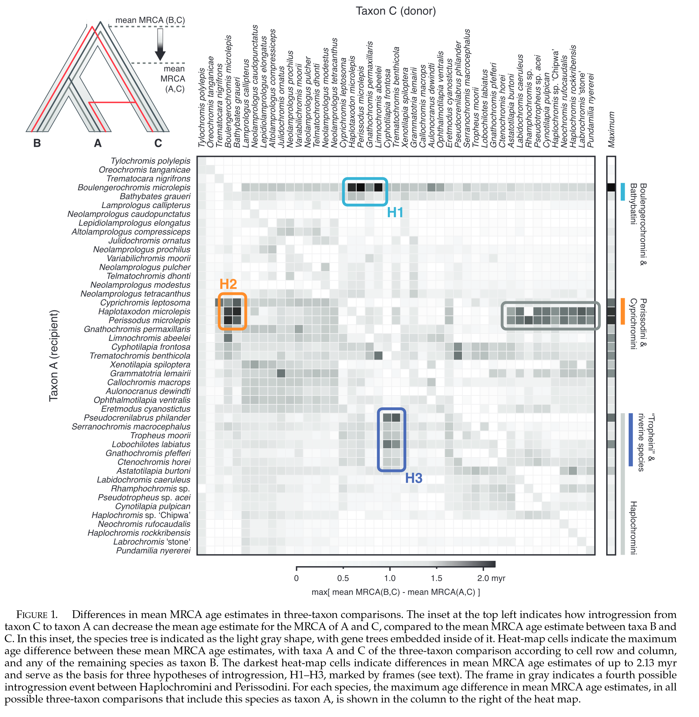

Slide 10
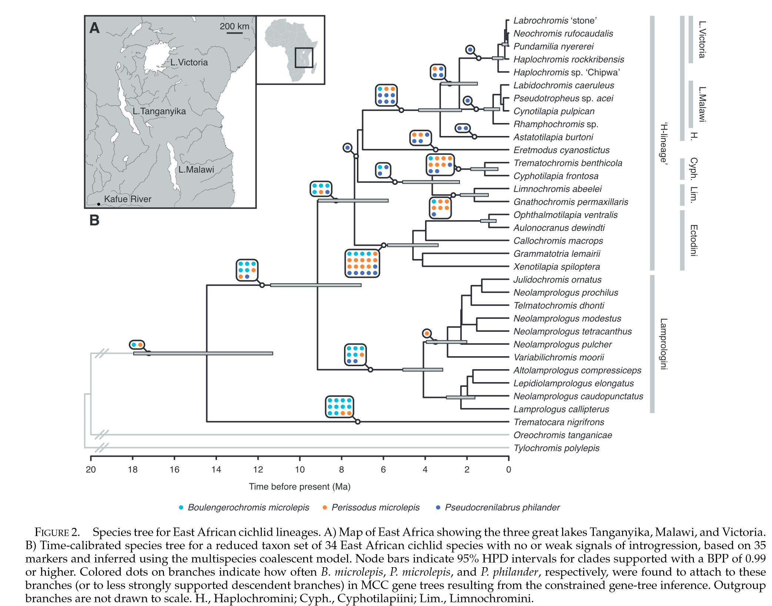

Slide 11
